Slide 1

Objectives
Intro For computer
Intro For Programming Language.
Machine Language
Intro for Python Programming Basics And IDE
python Programming language
Content
Introduction to Python and operations
Lists and Tuples
Strings
Dictionaries
Conditional and Looping Statements
Functions
Object-Oriented Programming
Date and Time
File Manipulation
Math In Python

Slide 2

Session 1 - Intro For Computers , Programming Language and Python

Slide 3
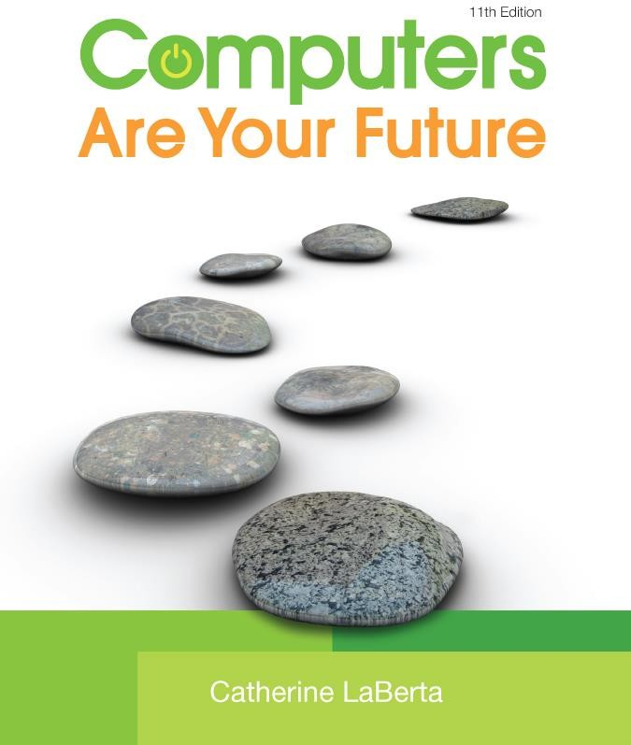
Computers Are Your Future
Eleventh Edition
Computers & You
Copyright © 2011 Pearson Education, Inc. Publishing as Prentice Hall
1

Slide 4
Objectives
Define the word computer and name the four basic operations that a computer performs.
Describe the two main components of a computer system: hardware and software.
Provide examples of hardware devices that handle input, processing, output, and storage tasks.
Give an example of the information- processing cycle in action.
Discuss the two major categories and the various types of computers.
Computer Fundamentals
A computer is a device that performs the information-processing cycle.
The information-processing cycle consists of four basic operations: input, processing, output, and storage.

Slide 5
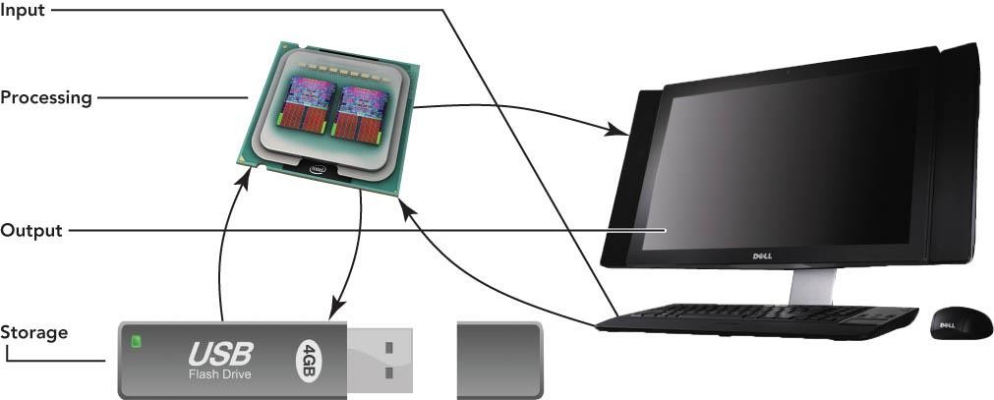
Computer Fundamentals

Slide 6
Computer Fundamentals
A computer system is a group of associated components that work together.
Computer system components are categorized into two main groups:
Hardware
Software
Hardware is made up of the physical parts of the computer and includes such components as the system unit, monitor, keyboard, and printer.
Software is made up of all the programs that instruct the computer.

Slide 7
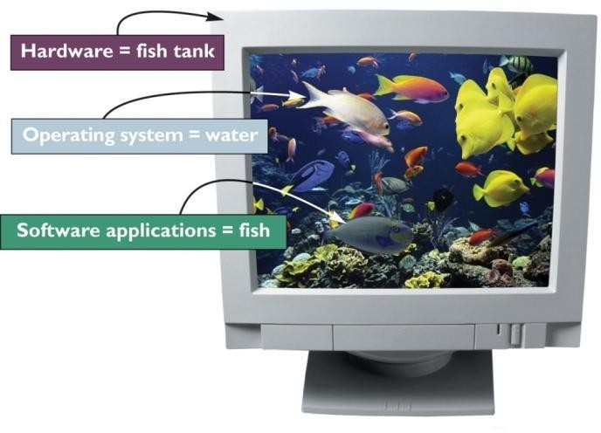
Computer Fundamentals
Software can be classified as one of the following types:
System software includes the programs that assist with the proper functioning of the computer.
Application software includes the programs used to perform tasks.
Computer Fundamentals
Input, the first operation of the information-processing cycle, enables the computer to accept data.
Data refers to facts that are raw and unorganized.
Data is entered into the computer for processing through the use of input devices such as a keyboard or mouse.

Slide 8
Computer Fundamentals
Processing, the second operation of the information-processing cycle, converts data into information.
Information refers to consolidated, organized, processed data.
The central processing unit (CPU)
processes data into information.
Random access memory (RAM) temporarily stores programs and data needed by the CPU.
Output, the third operation of the information-processing cycle, requires output devices such as monitors and printers to display results for people to see or hear.
Storage, the fourth operation of the information-processing cycle, holds programs, software, and data that the computer system uses.
Storage devices include hard drives, CD and DVD drives, and media card readers that are used with USB drives and flash memory cards.

Slide 9
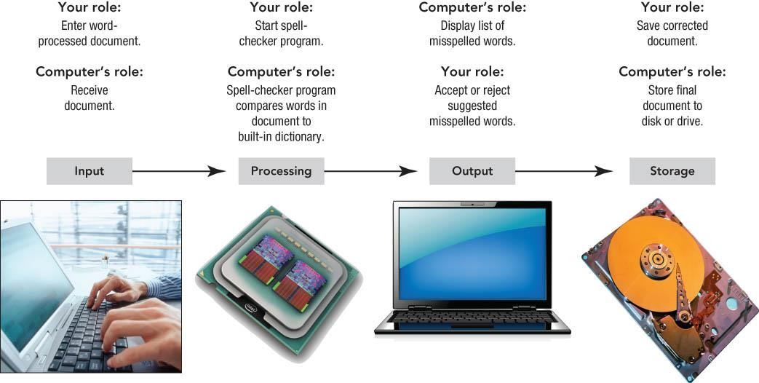
Computer Fundamentals

Slide 10
Types of Computers
Computers can be separated into two main types:
Computers for individuals are normally designed for one user at a time.
Computers for organizations are designed to be used by many people at the same time.
Computers for organizations
Servers enable users connected to a computer network to have access to the network’s programs, hardware, and data.
Clients include the user computers connected to the network.
A client/server network includes the use of client computers with centralized servers.

Slide 11
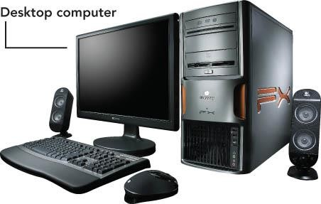
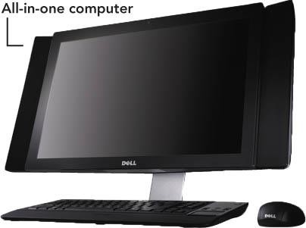
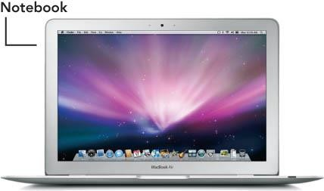
Types of Computers

Slide 12
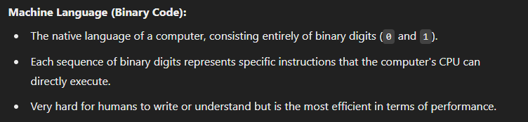
Language of Computer
refers to the different ways humans can communicate with computers to perform various tasks. Computers understand instructions in the form of programming languages, which can be categorized into different levels depending on their proximity to the machine's hardware or how understandable they are to humans.
1. Low-Level Languages:
These languages are closer to the hardware and are more difficult for humans to write but offer high performance and control over the computer’s components.
Assembly Language:
A step above machine language, using short codes (mnemonics) like MOV, ADD, and SUB instead of binary.
Each assembly instruction corresponds directly to a machine language instruction.
Easier for humans to read and write compared to machine language but still requires detailed knowledge of the computer's hardware.
Assembly code needs an assembler to convert it into machine code.

Slide 13
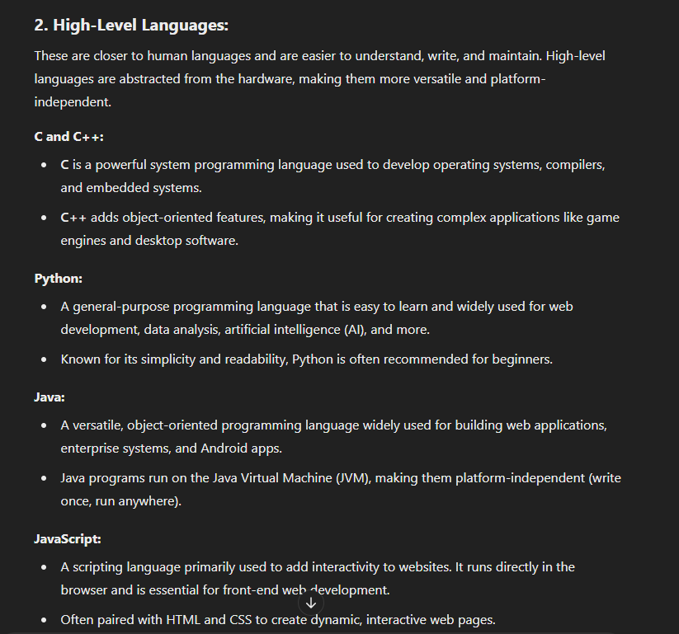

Slide 14
Understanding Binary, Decimal
Number Systems and Conversions
What is the Decimal System?
- The decimal system is a base-10 system that uses digits from 0 to 9.
- It's the number system we use in everyday life.
- Each digit represents a power of 10.
Example:
345 = (3 * 10^2) + (4 * 10^1) + (5 * 10^0) = 300 + 40 + 5
What is the Binary System?
- The binary system is a base-2 system that uses only 0 and 1.
- Computers operate using binary because they process data in 1s and 0s.
- Each digit represents a power of 2.
Example:
1011 (binary) = (1 * 2^3) + (0 * 2^2) + (1 * 2^1) + (1 * 2^0) = 8 + 0 + 2 + 1 = 11 (decimal)

Slide 15
Decimal to Binary Conversion
Binary to Decimal Conversion
- Multiply each binary digit by 2 raised to the power of its position.
Example:
1101 (binary) = (1 * 2^3) + (1 * 2^2) + (0 * 2^1) + (1 * 2^0) = 8 + 4 + 0 + 1 = 13 (decimal)
- Divide the decimal number by 2 and record the remainder.
- Repeat until the quotient is 0.
- The binary number is the remainders read from bottom to top.
Example:
13 (decimal) ÷ 2 → remainder = 1
6 ÷ 2 → remainder = 0
3 ÷ 2 → remainder = 1
1 ÷ 2 → remainder = 1
So, 13 (decimal) = 1101 (binary)

Slide 16
Programming Languages and Program Development
1

Slide 17
What is Programming
Program – a very specific set of instructions (or command lines) that making a computer do what you want it to do
Programming – the process of creating a program
🞑 the development of a solution to an identified program, and setting up of a related series of instructions which, when directed through computer hardware, will produce the desired results
3
Steps in program development
Define the problem
Outline the solution
Develop the outline into an algorithm
Test the algorithm for correctness
Code the algorithm into a specific programming language
Run the program on the computer
Document and maintain the program

Slide 18
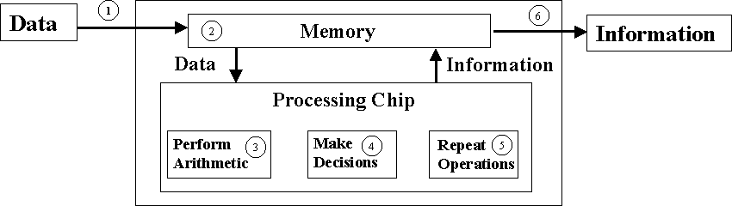
Define the Problem
Divide the problem into three components (called IPO):
🞑 Inputs – what do you have?
🞑 Outputs – what do you want to have?
🞑 Processing
how do you go from inputs to outputs?
A defining diagram is recommended
5

Slide 19
Outline the Solution
The major processing steps involved
The major subtasks (if any)
The major control structures (e.g. repetition loops)
The major variables and record structures
The mainline logic
7
Develop the Outline into an Algorithm
Algorithm is a set of precise steps that describe exactly the tasks to be performed, and the order in which they are to be carried out
Pseudocode (a form of structured English) is used to represent the solution algorithm

Slide 20
Test the Algorithm for Correctness
The main purpose of desk checking the algorithm is to identify major logic errors early, so that they may be easily corrected
Test data needs to be walked through each step in the algorithm, to check that the instructions described in the algorithm will actually do what they are supposed to
9
Code the Algorithm into a Specific Programming Language
Only after all design considerations have been
met should you actually start to code the program into your chosen programming language (e.g. Python , Visual Basic, Java, C++)
Run the Program on the Computer
This step uses a program compiler and programmer-designed test data to machine test the code for syntax errors
Program complier translate high-level languages (e.g. VB) to low-level machine language before execution

Slide 21
What is Python?
Python is a programming language.
Python is a general-purpose and advanced programming language.
Python applies to programming in many fields:
Data science
Writing system tools
Developing applications with graphical UIs
Writing network-based software
Interacting with databases
Development Environment of Python
IDLE: integrated development environment
Pycharm (Setup Link) → https://www.youtube.com/watch?v=XsL8JDkH-ec
Other editors: notepad++, editplus…

Slide 22
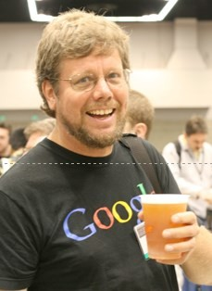
Origin of Python
Guido van Rossum:
Master of Mathematics
Master of Computer Science
Philosophy of Python:
Python is engineering but not art.
There should be one, and preferably only
one, obvious way to do it.
Simple is better than complex, and explicit is better than implicit.

Slide 23
Advantages of Python
Simple: Python is an ideal programming language of simplicity.
Easy-to-learn: few key words, simple structure, and explicit syntax
Open-source: Python is one of Free/Libre and Open-Source Software (FLOSS).
Interpretability: Python program does not need to be compiled into binary code, and can be directly run from source code.
Transplantability: Python has been transplanted to multiple platforms thanks to its open- source nature.
The platforms include Linux, Windows, FreeBSD, Macintosh, Solaris, OS/2, Amiga,
AROS, AS/400, BeOS, OS/390, z/OS, Palm OS, QNX, VMS,Psion, Acom RISC OS,
VxWorks, PlayStation, Sharp Zaurus, Windows CE, and even Symbian and Android developed by Google based on Linux.
Scalability: If you want to speed up running of some key code or keep some algorithms not open, you can write some programs using C or C++ and use them in Python.

Slide 24

Contents
Introduction to Python
Lists and Tuples
Strings
Dictionaries
Conditional and Looping Statements
Functions
Object-Oriented Programming
Date and Time
File Manipulation

Slide 25
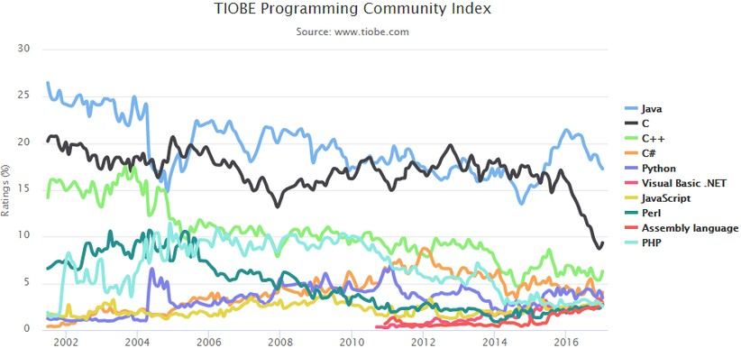
Popularity Ranking

Slide 26
What is a Variable in Python?
Introduction to Python Variables
- A variable in Python is a symbolic name for a value.
- It allows you to store, update, and use data.
- Python variables are dynamically typed and do not require prior declaration.
Example: x = 10
name = 'Alice'
is_valid = True
Rules for Naming Variables
- Must start with a letter or underscore (_).
- Can contain letters, numbers, and underscores.
- Python is case-sensitive: myVar and myvar are different.
- Cannot use reserved keywords (e.g., 'for', 'if').
Examples: valid_variable = 10
_underscore_var = 'Python‘
Invalid: 123number = 789, for = 'loop'

Slide 27
Variable Assignment and Initialization
- Variables are assigned using the '=' operator.
- Data types are determined by the value assigned.
- Python is dynamically typed.
Example: age = 25
name = 'John'
pi = 3.14159
is_active = True
Multiple Assignment in Python
- Assign values to multiple variables in a single line:
a, b, c = 5, 'Hello', True
- Assign the same value to multiple variables:
x = y = z = 100
Types of Data in Python Variables
Examples:
x = 10 # int
pi = 3.14 # float
name = 'John' # str
is_valid = False # bool
empty = None # NoneType
- Python supports various data types:
- Integers (int)
- Floats (float)
- Strings (str)
- Booleans (bool)
- None (NoneType)

Slide 28
Updating Variables
Checking Variable Type with type()
- Variables can be reassigned and even change types.
Example:
count = 5
count = count + 2 # Reassign
count = 'seven' # Now a string
- Use the 'type()' function to check the variable type.
Example:
x = 100
print(type(x)) # Output: <class 'int'>
name = 'Alice'
print(type(name)) # Output: <class 'str'>
Dynamic Typing in Python
- Python is dynamically typed; no need to declare types.
- The type is determined at runtime.
Example:
x = 42 # int
x = 'forty-two' # Now x is a string

Slide 29
Arithmetic Operations in Python
- Python supports basic arithmetic operations:
- Addition (+)
- Subtraction (-)
- Multiplication (*)
- Division (/)
Example: a = 10
b = 3
result_add = a + b # 13
result_sub = a - b # 7
result_mul = a * b # 30
result_div = a / b # 3.3333
More Arithmetic Operations
- Additional operators:
- Modulus (%)
Example:
a = 10
b = 3
result_mod = a % b # 1

Slide 30
Contents
Introduction to Python
Lists and Tuples
Strings
Dictionaries
Conditional and Looping Statements
Functions
Object-Oriented Programming
Date and Time
File Manipulation

Slide 31
Lists
Functions of Python Lists
A list is an ordered set of elements that you can add and delete at
any time.
The element types in the list can be different. You can access each element in the list by index. The first digit of the index starts from 0. and last by referese -1
cmp(list1, list2),
len(list)
max(list)
min(list)
list(seq)
Common Operations on Lists
Access
Update (append and insert)
Delete elements (del)
Operator on list script (+/*)
List interception

Slide 32
Methods of Python Listing
list.append(obj)
list.count(obj)
list.extend(seq)
list.index(obj)
list.insert(index, obj)
list.pop(obj=list[-1])
list.remove(obj)
list.sort([func])
list.reverse()

Slide 33
>>>x = [1, 2, 3]
Understand the difference between "append" and "extend".
Copy a list.
#Method one:
new_list = old_list[:] #Method two:
new_list = list(old_list)
Get last element of a list
>>> a = [1, 2, 3, 4, 5, 6, 7, 8, 9, 10]
>>> a[len(a)-1] 10
>>> a[-1]
10
>>>x = [1, 2, 3]
>>>y = [4, 5]
>>>x.extend(y) # equal to
>>>for i in y:
>>>x.append(i)
>>>print(x) [1,2,3,4,5]
>>>y = [4, 5]
>>>x.append(y)
>>>print(x) [1,2,3,[4,5]]
Check whether the list is empty.
if len(items) == 0:
print("empty list") #or
if items == []:
print("empty list")

Slide 34
Remove elements from a list.
>>> a = [0, 2, 2, 3]
>>> a.remove(2)
>>> a [0, 2, 3]
# ValueError will be returned if the removed element is not within
the list.
>>> a.remove(7)
Traceback (most recent call last):
File "<stdin>", line 1, in <module>
ValueError: list.remove(x): x not in list·
"del" removes a certain element in a specified position.
"pop" is similar to "del", but "pop" can return the removed element.
Connect two lists.
>>>listone = [1, 2, 3]
>>>listtwo = [4, 5, 6]
>>>mergedlist = listone + listtwo
>>>print(mergelist) [1, 2, 3, 4, 5, 6]

Slide 35
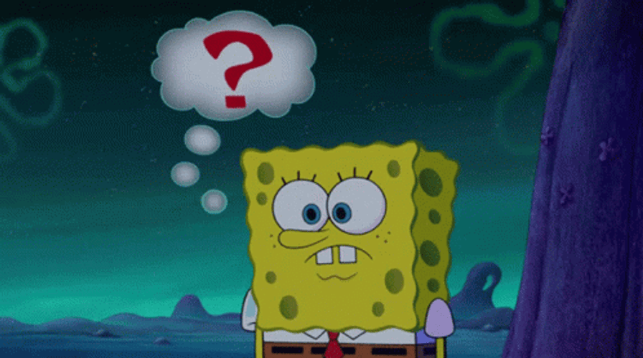

Slide 36

Thanks
www.huawei.com
For Any Question
Engineer/Fady Zaher
WhatsApp/01273826361

